Slide 1
The Calm Before The Score
Group F - Third and Long
Oct
6
Maheen Abdulwaheed, Ami Patel,
Gautam Iyer, Sheyla Perez Nazco,
Ashley Moore, Dantrell Person,
Marjorie Muñoz, Fannie Polcari,
Elena Ortiz, Austin Skorb, &
Daniel Webber

Slide 2
Traveling can be a stressful experience, even when visiting a favorite team
Issues may include:
Bad weather
Sold out games
Packed stadiums
But most importantly… how will one’s team perform?
If someone is going to travel to a football game, then they’d probably like to see their team win, especially at their home stadium!
Is there a way we can make it easier for fans to decide?

Slide 3
With Data, of course!
We used the following data for the 2021 NFL season from SportsData.io API:
Home Team Name | Attendance per Game
Home Team Scores | Stadium Capacity
Away Team Name | Stadium Name
Away Team Scores | Team Logo
Forecasted High Temperature | City, State
Forecasted Low Temperature | Stadium Type
Turf Type | Game Week

Slide 4
How did we munge the data?
ETL Steps:
We used a Jupyter Notebook to make 3 different calls to the API to get 2021 score data, stadium data and 2021 team data.
The score data was converted into a DataFrame which contained 272 rows (one for each game).
Unnecessary columns were dropped from the dataset.
The stadium data was merged into the score data using the “StadiumID” field. This allowed us to get stadium information for each game played.
The team data was then merged into the new DataFrame using the “HomeTeam” field. This allowed us to get different hometeam stats for each game played.
Loaded our new dataframe into MongoDB.

Slide 5
Working with the Clean Data
Created an app.py to use a Python Flask API that calls info from MongoDB and renders the index.html template.
Created an app.js to define functions which:
Pulls data from our Flask Powered API
Charts a line graph for Team scores for each Home Game
Graphs a scatter chart for High and Low Forecast Temperatures
Plots a bar chart for Stadium Capacity vs. Game Day Attendance
Modified the index.html file to include:
A drop-down menu to pick a Home Team
A bootstrap powered navigation bar
Our 3 visualizations
And images and facts about the selected team

Slide 6








THE CALM BEFORE THE SCORE PUPPY BOWL HALFTIME SHOW
FEATURING PITBULL AND SNOOP DOGG

Slide 7
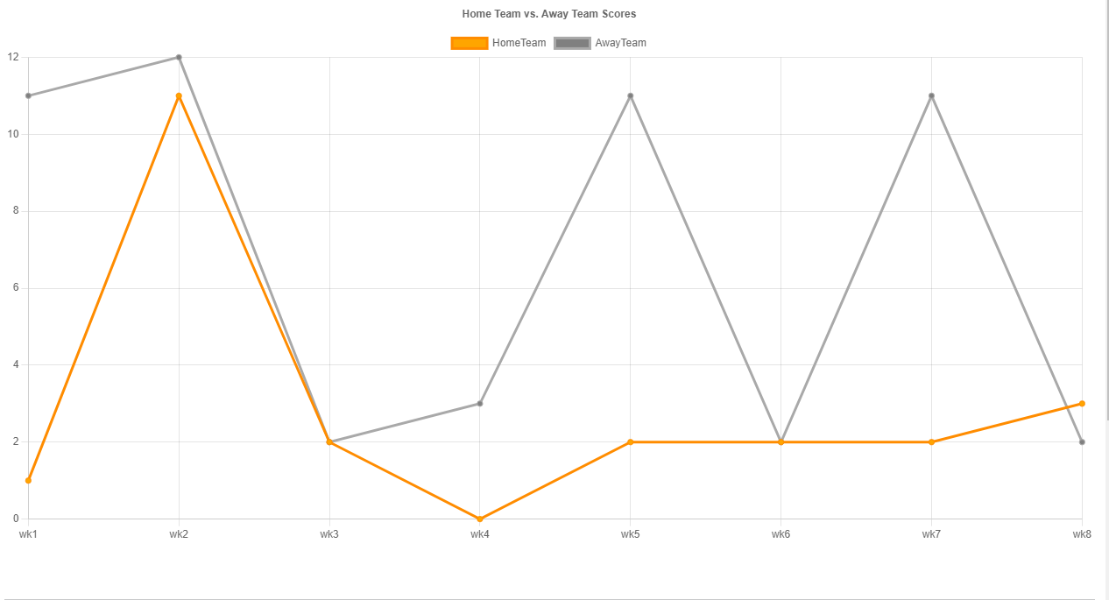
Nice Visualization #1
Home Team Season Scores vs. Away Team
New Javascript Library Used: Charts.js
Notes:
Atlanta Falcons selected as Home Team. This chart was developed using a new library called Charts.js

Slide 8
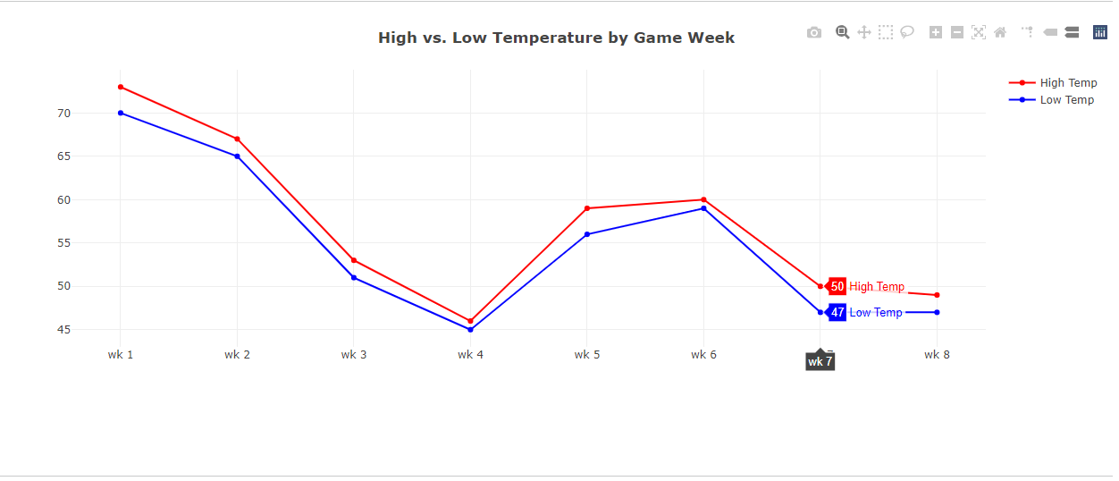
Nice Visualization #2
High vs. Low Temperature by Game Week
Notes:
Atlanta Falcons Game Week. By week 8 , the temperatures were a bit cooler and pleasant for anyone to attend the game.

Slide 9
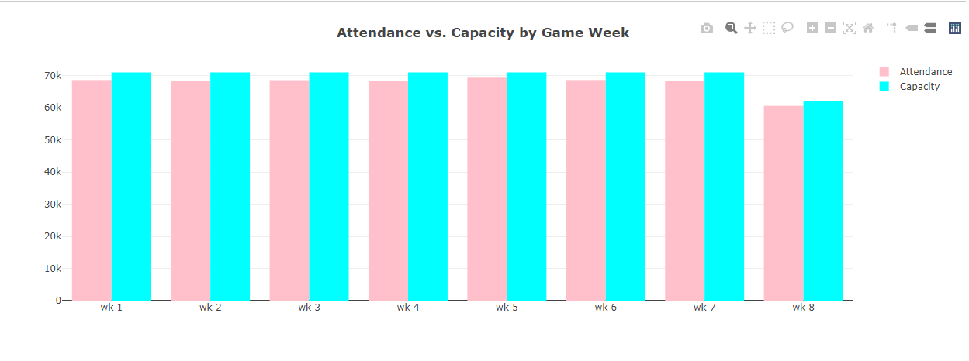
Nice Visualization #3
Attendance vs. Capacity by Game Week
Notes:
Atlanta Falcon’s Attendance Vs. Capacity Chart. The last week’s attendance was the least as compared to the rest of the games.

Slide 10
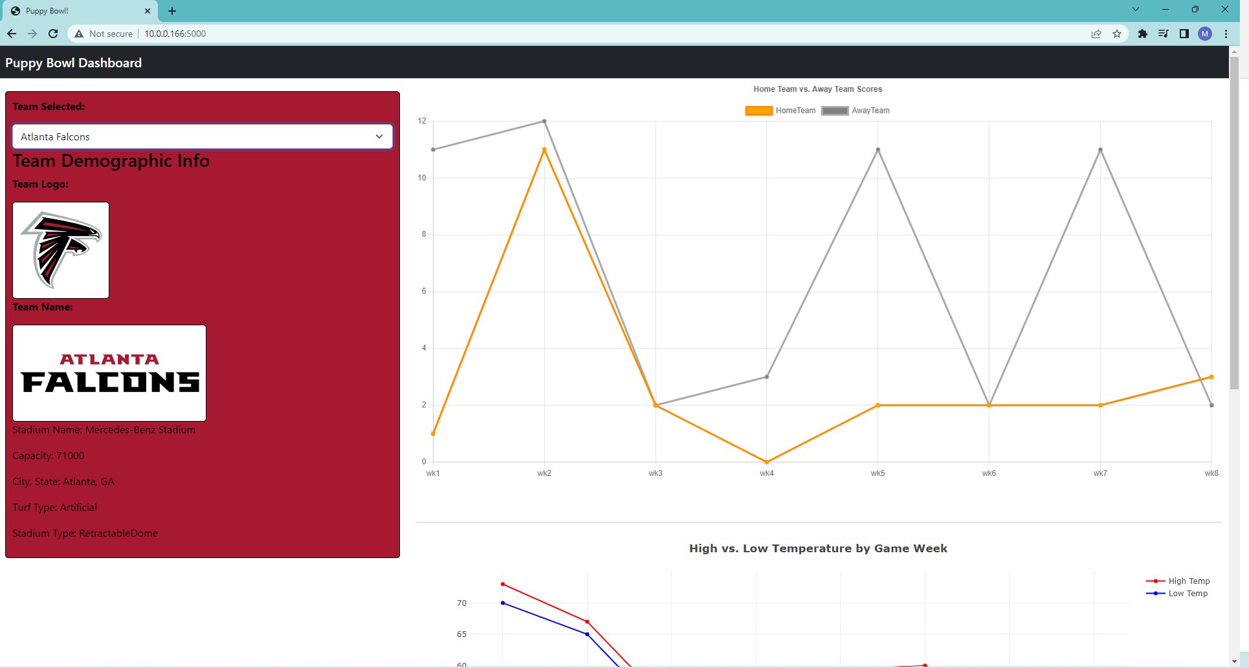
Let’s Show the Website!

Slide 11
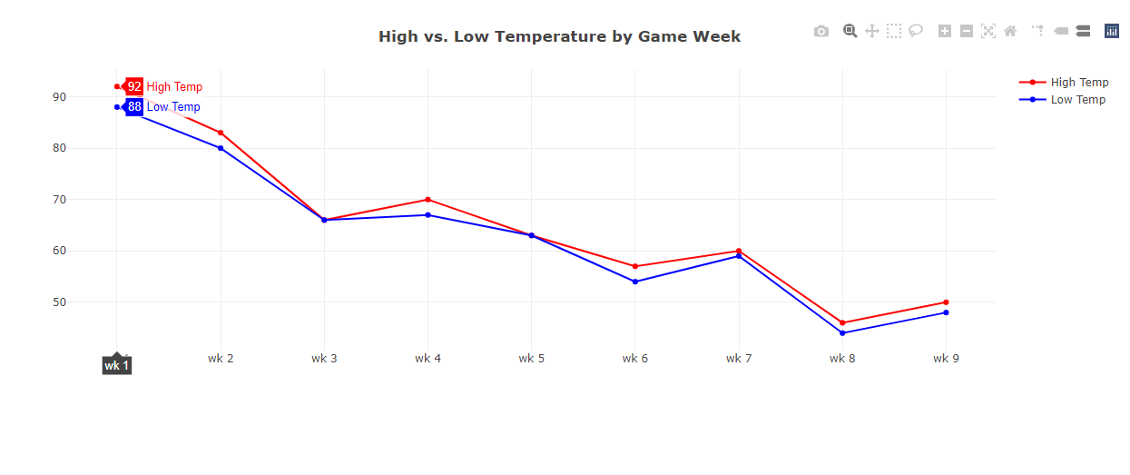
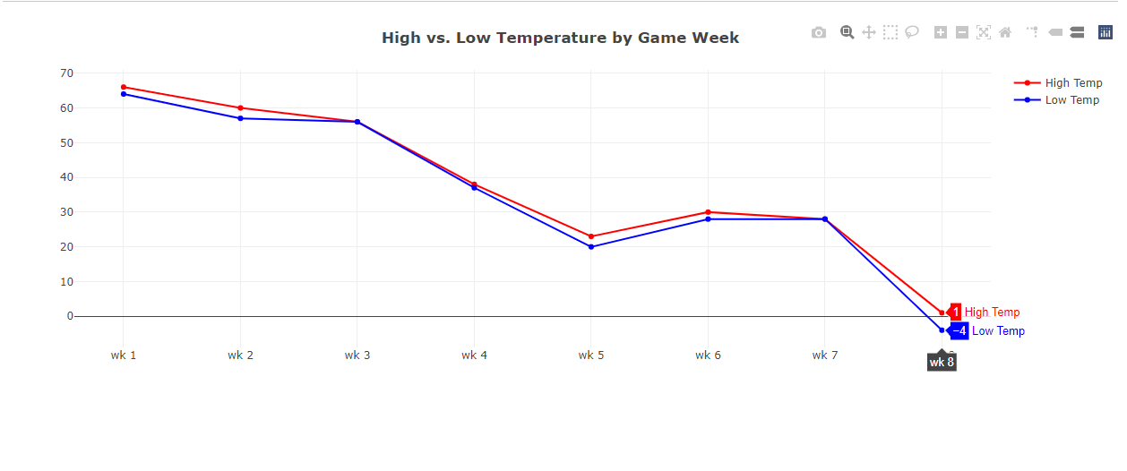
Comparing Temp Charts
Week 1 - Las Vegas Temp
Week-8 -Minnesota Temp

Slide 12
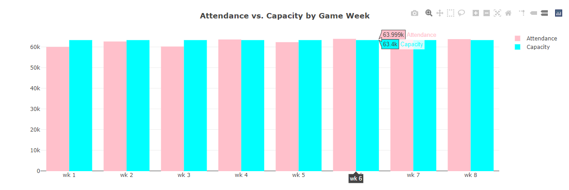
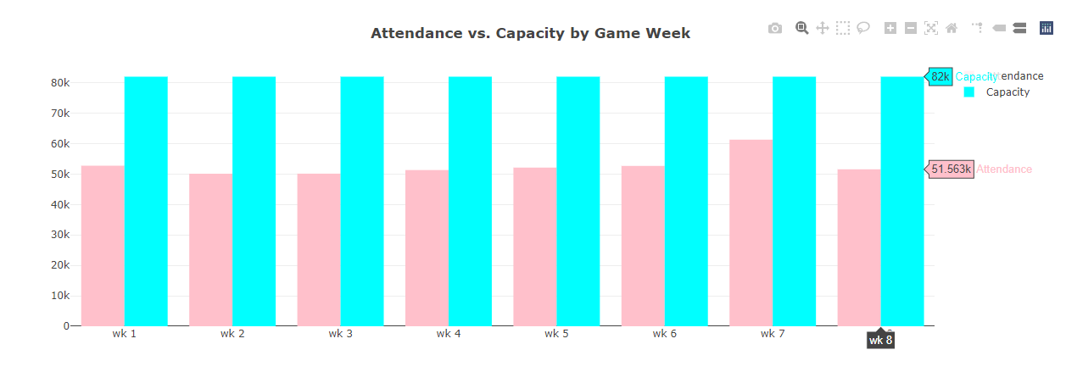
Comparing Attendance Charts
Arizona Cardinals attendance beyond capacity
Washington-
Commanders Capacity

Slide 13
Alright, let’s start winding down… with our observations.
The function called at the end of *.js doesn't have to be "init()".
The original dataset had the same stadium listed twice due to name changes.
The Falcons and Jaguars had abnormal Temperature charts in October and January, while playing abroad.
The Highest Forecasted Temp was 92° F in Las Vegas, the Lowest Forecasted Temp was -4° F in Minneapolis.
No one attends the Washington Commanders Games…

Slide 14

Thank you!

